Slide 1
Modern Programming Languages
UIIT PMAS Arid Agriculture University, Rawalpindi
Course Instructor: Suleman Khurram

Slide 2
What we will learn in this lecture…
Interactive programs and scanner
Using built-in String Class Methods
The StringBuffer
StringTokenizer Class

Slide 3
Interactive programs
We have written programs that print console output, but it is also possible to read input from the console.
The user types input into the console. We capture the input and use it in our program.
Such a program is called an interactive program.
Interactive programs can be challenging.
Computers and users think in very different ways.
Users misbehave.
3

Slide 4
Input and System.in
System.out
An object with methods named println and print
System.in
not intended to be used directly
We use a second object, from a class Scanner, to help us.
Constructing a Scanner object to read console input:
Scanner name = new Scanner(System.in);
Example:
Scanner console = new Scanner(System.in);
4

Slide 5
Java class libraries, import
Java class libraries: Classes included with Java's JDK.
organized into groups named packages
To use a package, put an import declaration in your program.
Syntax:
// put this at the very top of your program
import packageName.*;
Scanner is in a package named java.util
import java.util.*;
To use Scanner, you must place the above line at the top of your program (before the public class header).
5

Slide 6
Scanner methods
Method | Description
nextInt() | reads a token of user input as an int
nextDouble() | reads a token of user input as a double
next() | reads a token of user input as a String
nextLine() | reads a line of user input as a string
The value typed is returned.
System.out.print("How old are you? ");
int age = console.nextInt();
System.out.println("You'll be 40 in " +(40 - age) + "years.");
6

Slide 7
Example Scanner usage
import java.util.*; // so that I can use Scanner
public class ReadSomeInput {
public static void main(String[] args) { Scanner console = new Scanner(System.in);
System.out.print("How old are you? "); int age = console.nextInt();
System.out.println(age + "... That's quite old!");
}
}
Output (user input underlined):
How old are you? 14 14... That's quite old!
7

Slide 8
Another Scanner example
import java.util.*; // so that I can use Scanner public class ScannerSum {
public static void main(String[] args) { Scanner console = new Scanner(System.in);
System.out.print("Please type three numbers: "); int num1 = console.nextInt();
int num2 = console.nextInt();
int num3 = console.nextInt();
int sum = num1 + num2 + num3; System.out.println("The sum is " + sum);
}
}
Output (user input underlined): Please type three numbers: 8 6 13 The sum is 27
⚫ The Scanner can read multiple values from one line.
8

Slide 9
Input tokens
Token: A unit of user input, as read by the Scanner.
Tokens are separated by whitespace (spaces, tabs, newlines).
How many tokens appear on the following line of input?
23 John Smith 42.0 "Hello world" $2.50 " 19"
When a token is not the type you ask for, it crashes.
System.out.print("What is your age? "); int age = console.nextInt();
Output:
What is your age? Timmy
java.util.InputMismatchException
at java.util.Scanner.next(Unknown Source)
at java.util.Scanner.nextInt(Unknown Source)
...
9

Slide 10
Scanners as parameters
If many methods read input, declare a Scanner in main and pass it to the others as a parameter.
public static void main(String[] args) {
Scanner console = new Scanner(System.in);
int sum = readSum3(console);
System.out.println("The sum is " + sum);
}
// Prompts for 3 numbers and returns their sum.
public static int readSum3(Scanner console) {
System.out.print("Type 3 numbers: ");
int num1 = console.nextInt();
int num2 = console.nextInt();
int num3 = console.nextInt();
return num1 + num2 + num3;
}
9

Slide 11
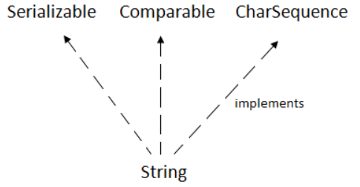
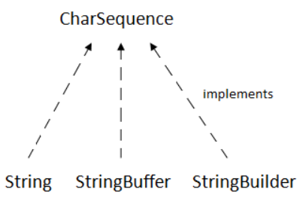
String

Slide 12

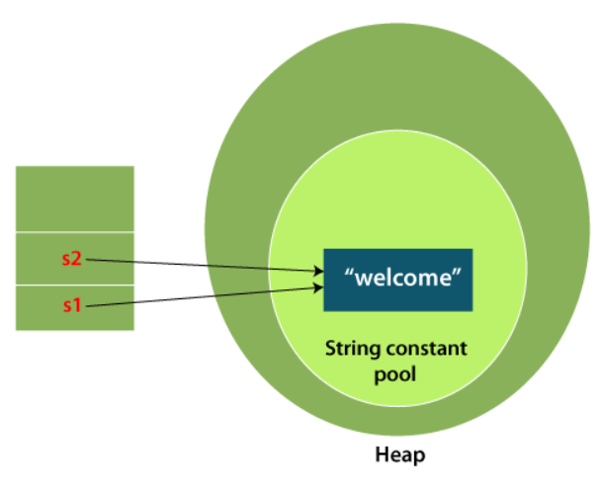
String

Slide 13
String
There are two ways to create a String in Java
String literal
String str1 = "Welcome";
String str2 = "Welcome";
Using new keyword
String str1 = new String("Welcome");
String str2 = new String("Welcome");

Slide 14
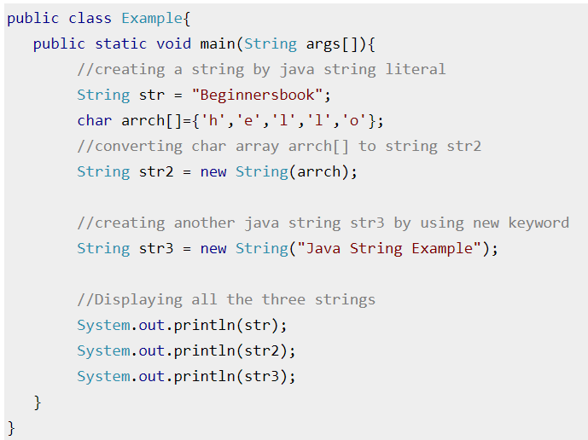
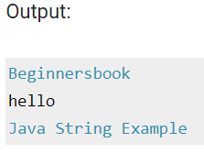
String example

Slide 15
String methods
https://www.javatpoint.com/java-string

Slide 16
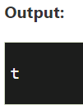
Java String charAt() Java String charAt()
The Java String class charAt() method returns a char value at the given index number.
public class CharAtExample{
public static void main(String args[]){
String name="javatpoint";
char ch=name.charAt(4);//returns the char value at the 4th index
System.out.println(ch);
}}

Slide 17
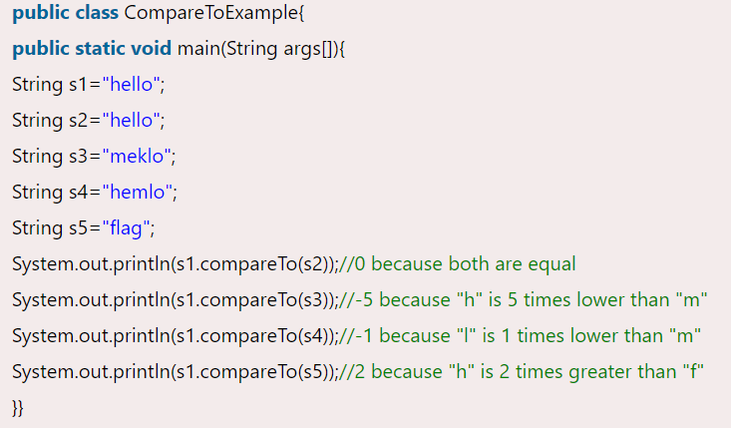
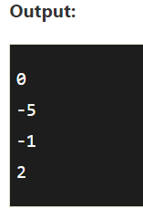
Java String compareTo()
The Java String class compareTo() method compares the given string with the current string lexicographically. It returns a positive number, negative number, or 0.

Slide 18
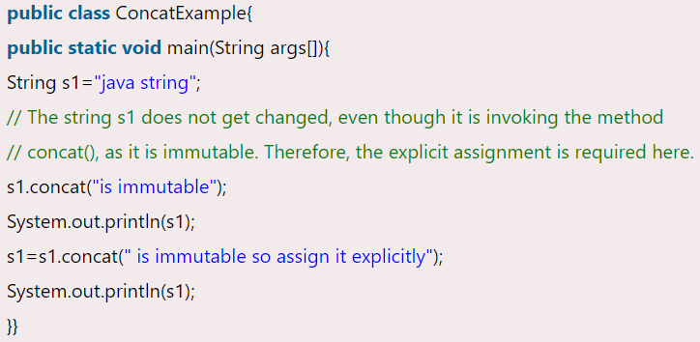
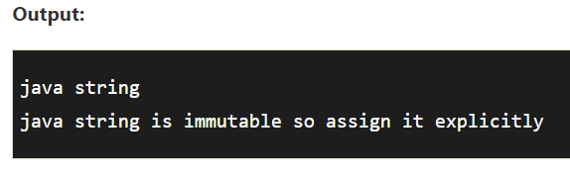
Java String concat()
The Java String class concat() method combines specified string at the end of this string. It returns a combined string. It is like appending another string.

Slide 19
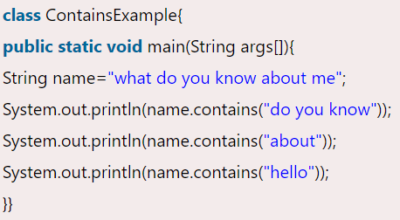
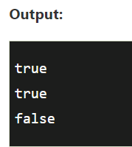
Java String contains()
The Java String class contains() method searches the sequence of characters in this string. It returns true if the sequence of char values is found in this string otherwise returns false.

Slide 20
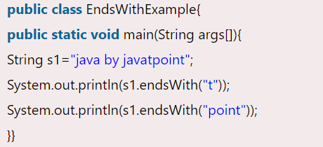
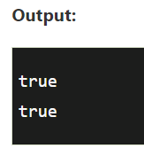
Java String endsWith()
The Java String class endsWith() method checks if this string ends with a given suffix. It returns true if this string ends with the given suffix; else returns false.

Slide 21
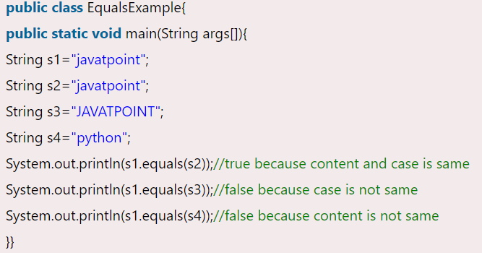
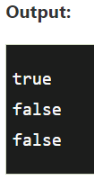
Java String equals()
The Java String class equals() method compares the two given strings based on the content of the string. If any character is not matched, it returns false. If all characters are matched, it returns true.
The String equals() method overrides the equals() method of the Object class.
Another is equalsIgnoreCase().

Slide 22
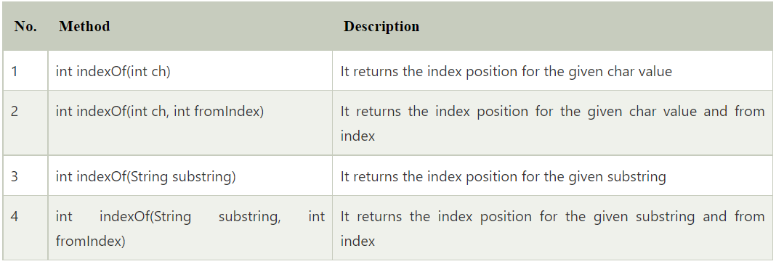
Java String indexOf()
The Java String class indexOf() method returns the position of the first occurrence of the specified character or string in a specified string.
Another is lastIndexOf()

Slide 23
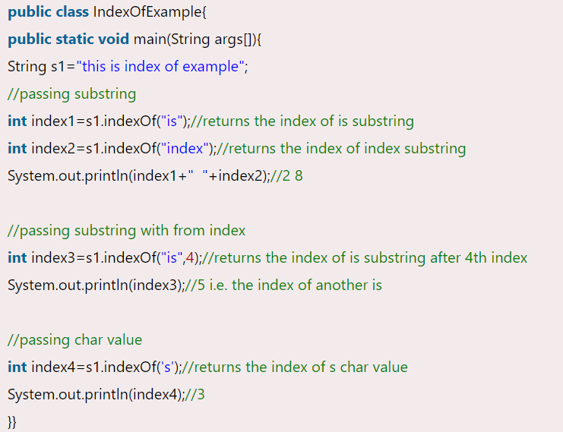
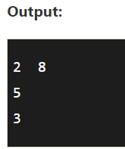
Java String indexOf()

Slide 24
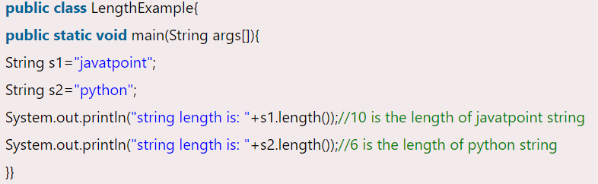
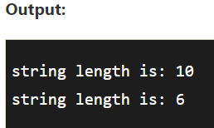
Java String length()
The Java String class length() method finds the length of a string. The length of the Java string is the same as the Unicode code units of the string.

Slide 25
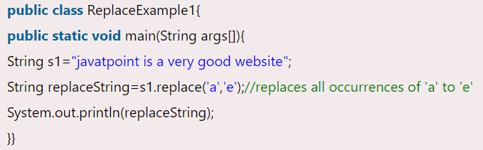
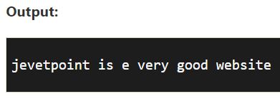
Java String replace()
The Java String class replace() method returns a string replacing all the old char or CharSequence to new char or CharSequence.
Another is replaceAll().
Notes:
replaceAll works with regex

Slide 26
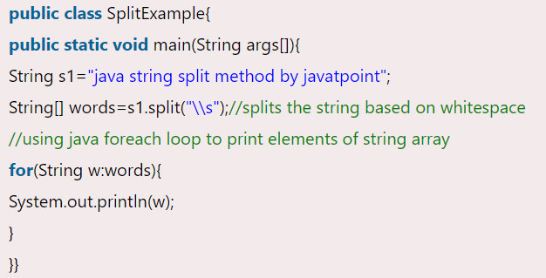
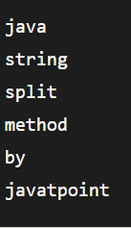
Java String split()
The java string split() method splits this string against given regular expression and returns a char array.

Slide 27
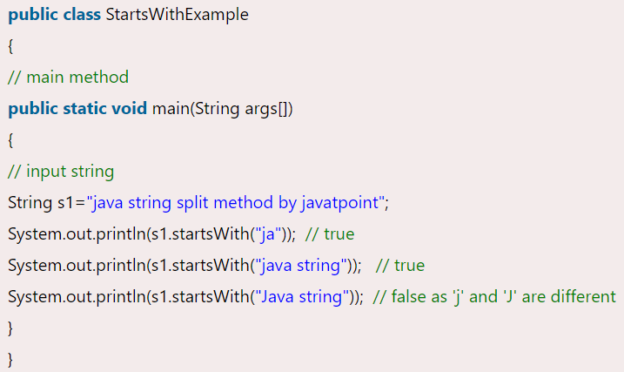
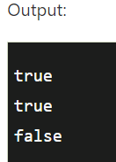
Java String startsWith()
The Java String class startsWith() method checks if this string starts with the given prefix. It returns true if this string starts with the given prefix; else returns false.

Slide 28
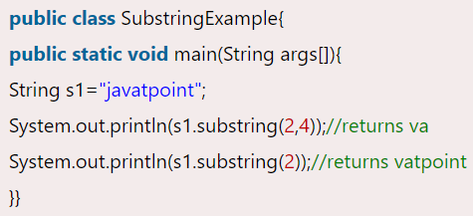
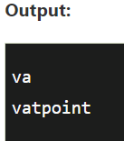
Java String substring()
The Java String class substring() method returns a part of the string.

Slide 29
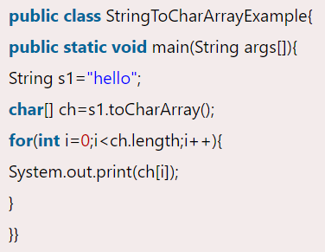
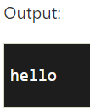
Java String toCharArray()
The java string toCharArray() method converts this string into character array. It returns a newly created character array, its length is similar to this string and its contents are initialized with the characters of this string.

Slide 30
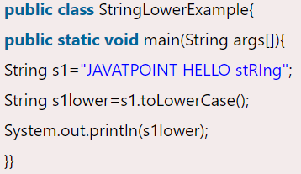
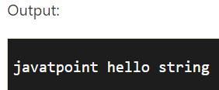
Java String toLowerCase()
The java string toLowerCase() method returns the string in lowercase letter. In other words, it converts all characters of the string into lower case letter.
Another is toUpperCase().

Slide 31
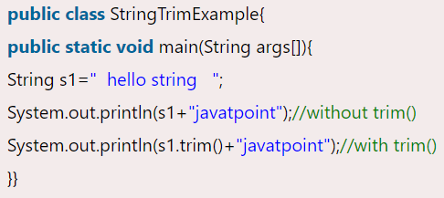
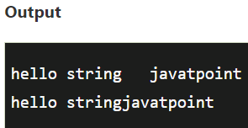
Java String trim()
The Java String class trim() method eliminates leading and trailing spaces.

Slide 32
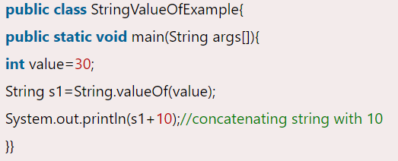
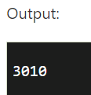
Java String valueOf()
The java string valueOf() method converts different types of values into string.

Slide 33
Java StringBuffer Class
Java StringBuffer class is used to create mutable (modifiable) String objects. The StringBuffer class in Java is the same as String class except it is mutable i.e. it can be changed.
Java StringBuffer class is thread-safe i.e. multiple threads cannot access it simultaneously. So it is safe and will result in an order.

Slide 34
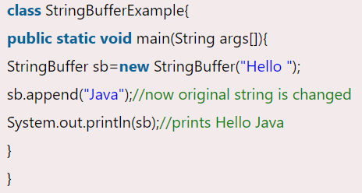
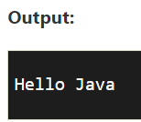
Java StringBuffer Class

Slide 35
Java StringBuffer Class Method
StringBuffer insert() Method
StringBuffer replace() Method
StringBuffer delete() Method
StringBuffer reverse() Method
StringBuffer capacity() Method
StringBuffer ensureCapacity() method

Slide 36
StringBuffer capacity() Method
The capacity() method of the StringBuffer class returns the current capacity of the buffer.
The default capacity of the buffer is 16. If the number of character increases from its current capacity, it increases the capacity by (oldcapacity*2)+2. For example if your current capacity is 16, it will be (16*2)+2=34.

Slide 37
StringBuffer ensureCapacity() method
The ensureCapacity() method of the StringBuffer class ensures that the given capacity is the minimum to the current capacity.
sb.ensureCapacity(50);

Slide 38
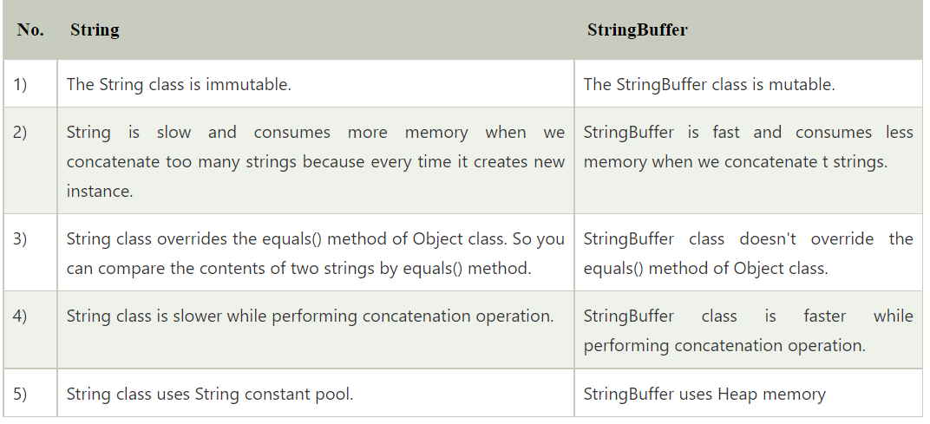
String vs StringBuffer

Slide 39
Java StringBuilder Class
Java StringBuilder class is used to create mutable (modifiable) String. The Java StringBuilder class is same as StringBuffer class except that it is non-synchronized. It is available since JDK 1.5.

Slide 40
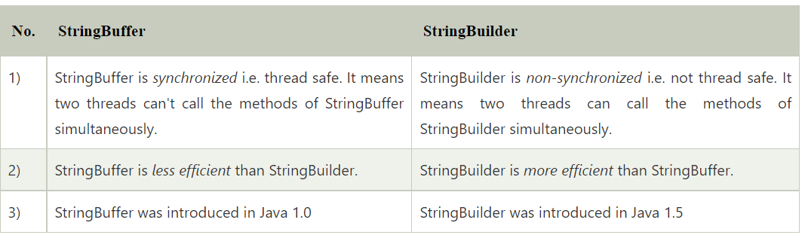
StringBuffer vs StringBuilder

Slide 41
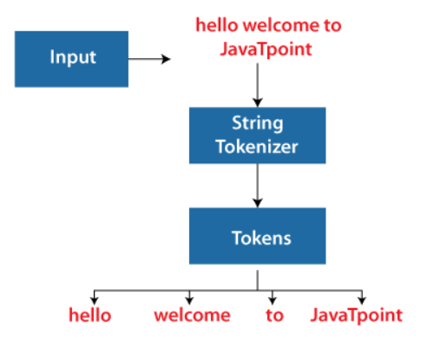
StringTokenizer
The java.util.StringTokenizer class allows you to break a String into tokens. It is simple way to break a String. It is a legacy class of Java.

Slide 42
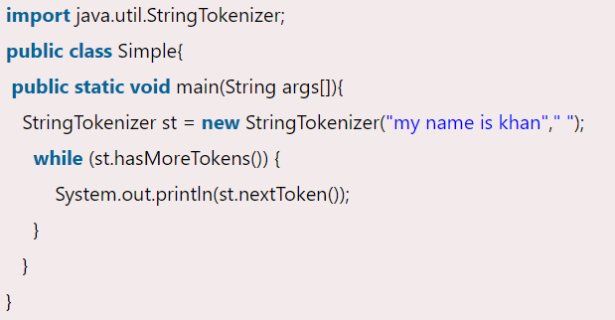
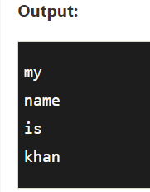
StringTokenizer

Slide 43
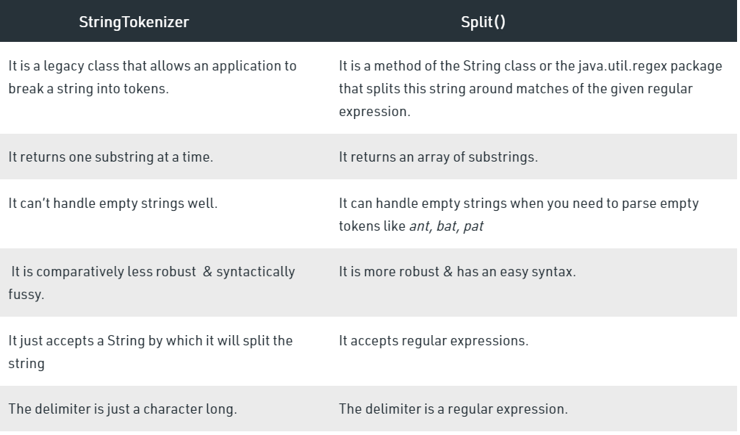
StringTokenizer vs Split

Slide 44
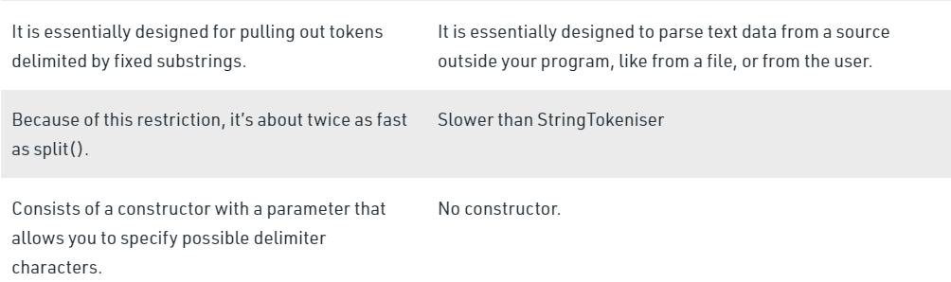
StringTokenizer vs Split

Slide 45
Exercise
Store the following string in a string variable:
“My university name is Arid, Agriculture University.”
Perform following tasks on this string:
Remove comma after word “Arid”.
Print only the university name removing extra information from the sentence.
Print the whole sentence in lower case.
Print each token using a loop.

Slide 46
Exercise
Store the following string in a string variable:
“My university name is Arid, Agriculture University.”
Print all the tokens using StringTokenizer.
Use String buffer to store “Welcome ”, then take the name as input from the user and append it to the string buffer and print to the console.
Output will be like: Welcome Suleman

